Slide 1
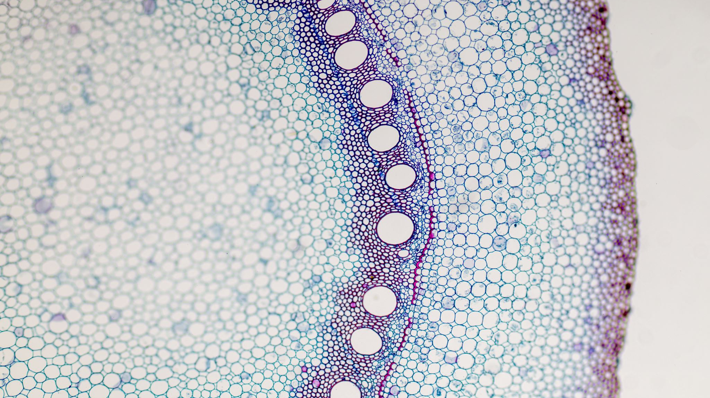
Mechanism Of Transcription Factor TFAP2-Γ
By: Devin Carree

Slide 2
Mechanism of Transcription Factor AP2- Γ (TFAP2- Γ)
Dr. Jason Knott’s Lab; Reproductive and Developmental Sciences Program (RDSP)
Aim: Identifying transcriptional mechanism that control pre-implementation embryo development and trophoblast lineage formation
Mouse Model

Slide 3
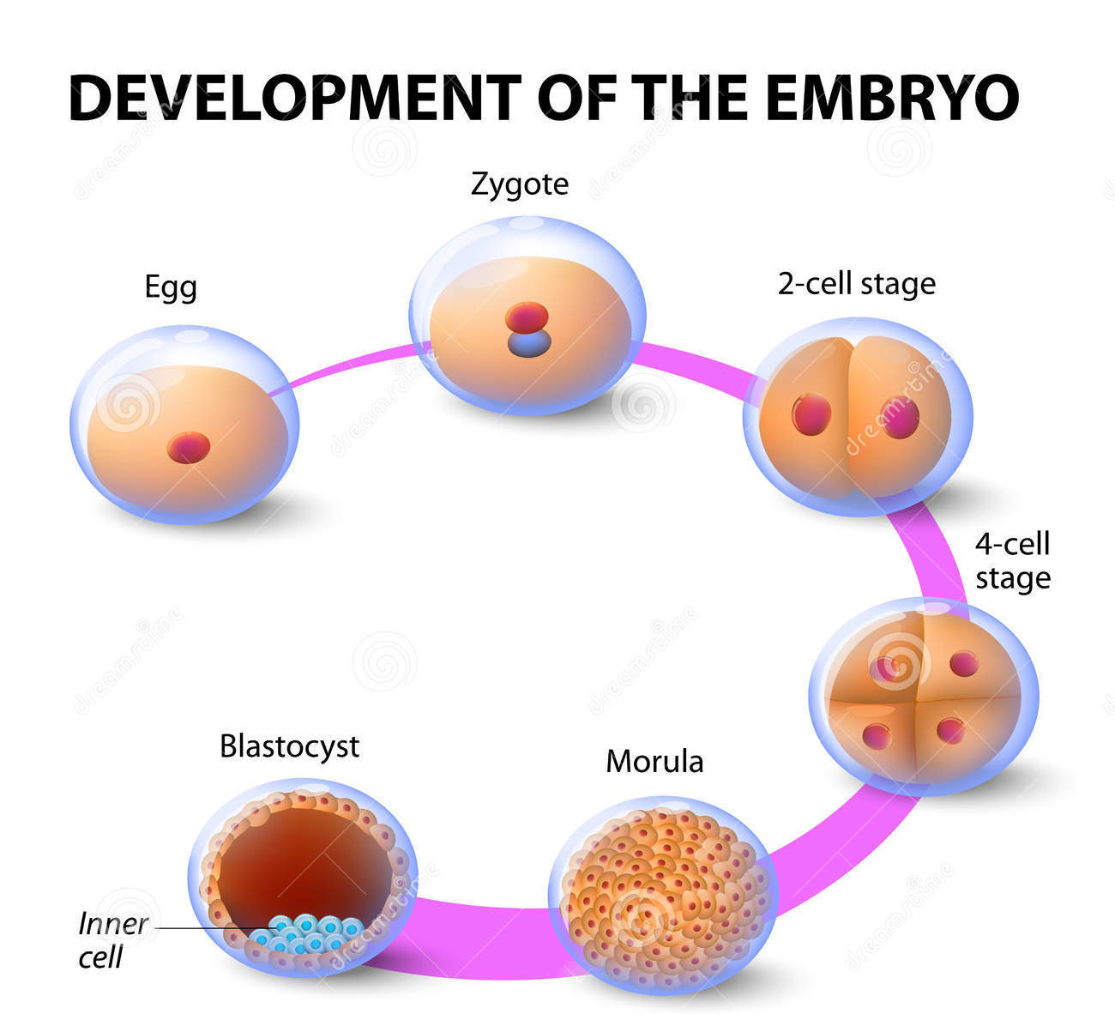
Function of TFAP2-Γ
TFAP2- Γ: core regulator in blastocyst formation
drives cell differentiation to trophectoderm cell linage
binds and regulates a diverse group of genes expressed during blastocyst formation
regulates genes important for tight junctions, cell polarity and fluid accumulation

Slide 4
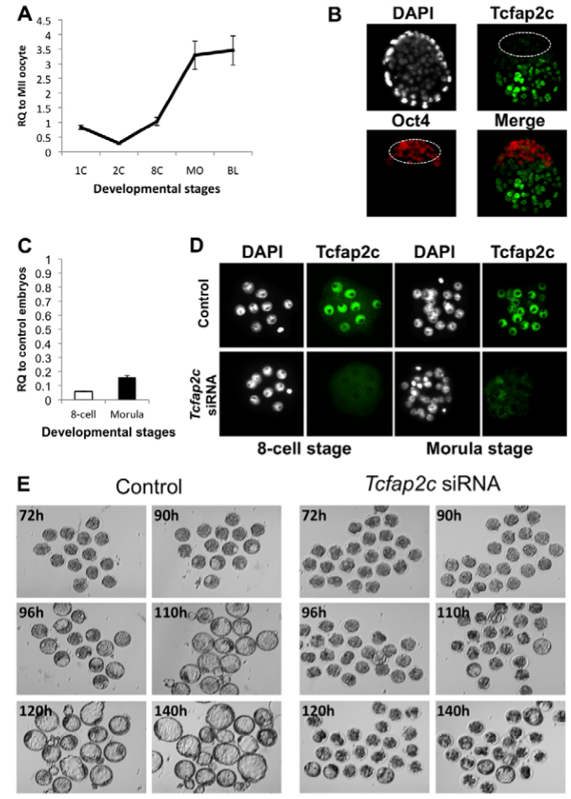
Results of TFAP2-Γ study

Slide 5
Lab responsibilities
Purification of plasmids
Immunocytochemistry
Bacterial Transformation
Restriction digest

Slide 6
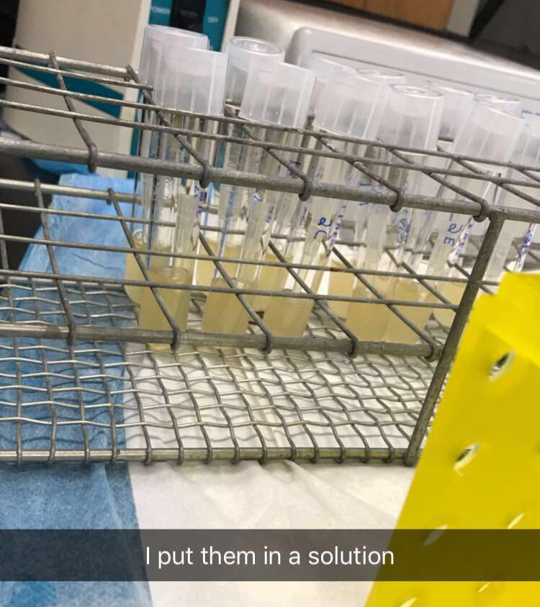
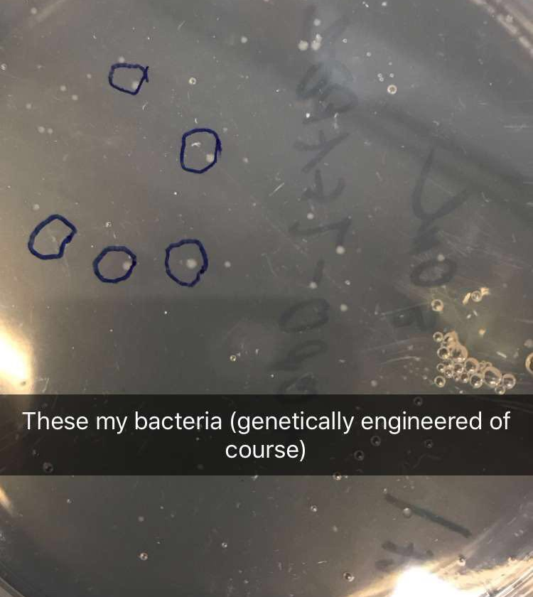
Bacterial Transformation

Slide 7
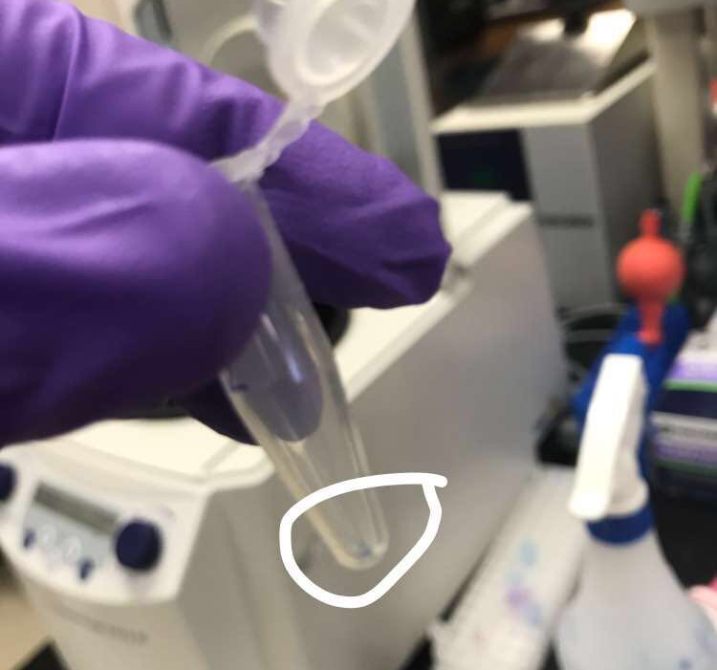
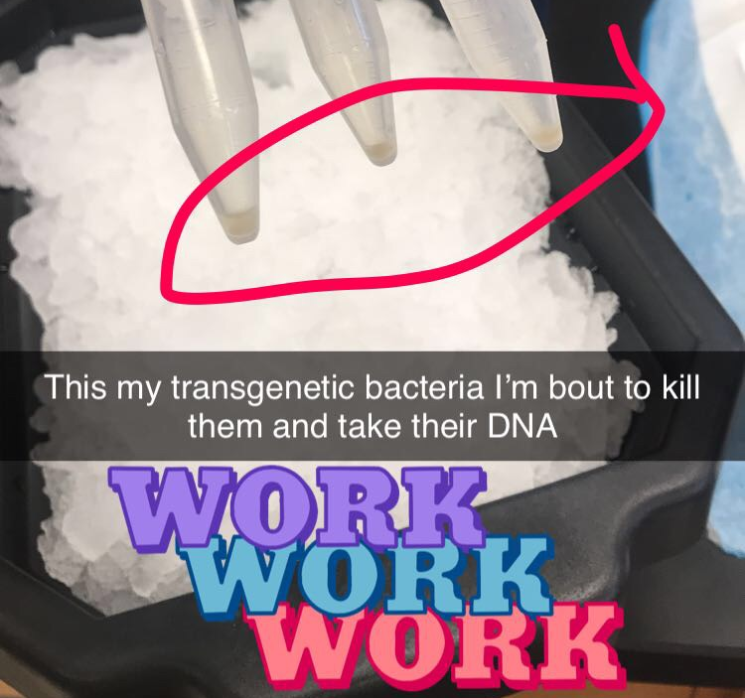
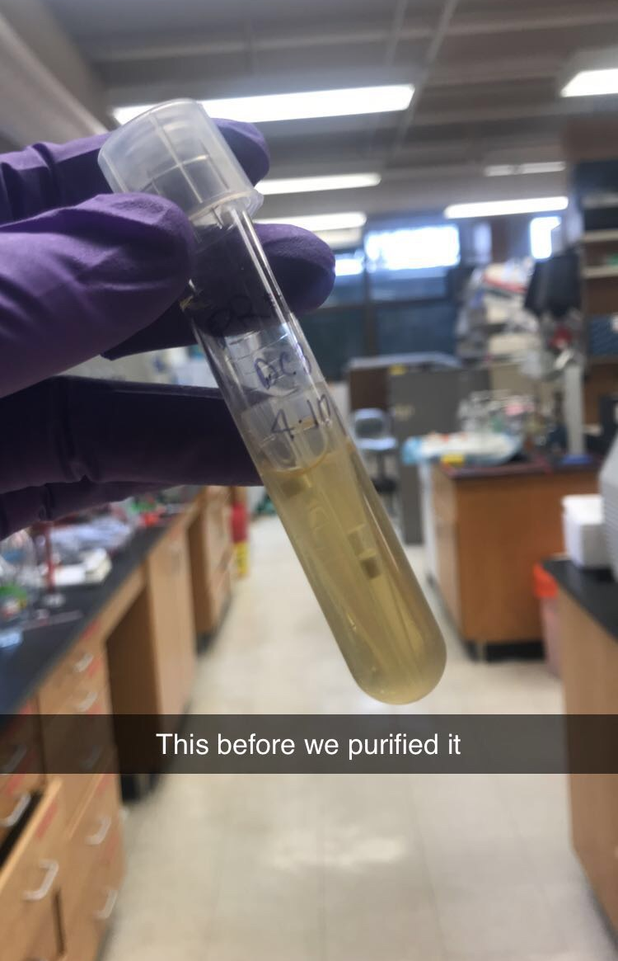
Purification of Plasmid

Slide 8
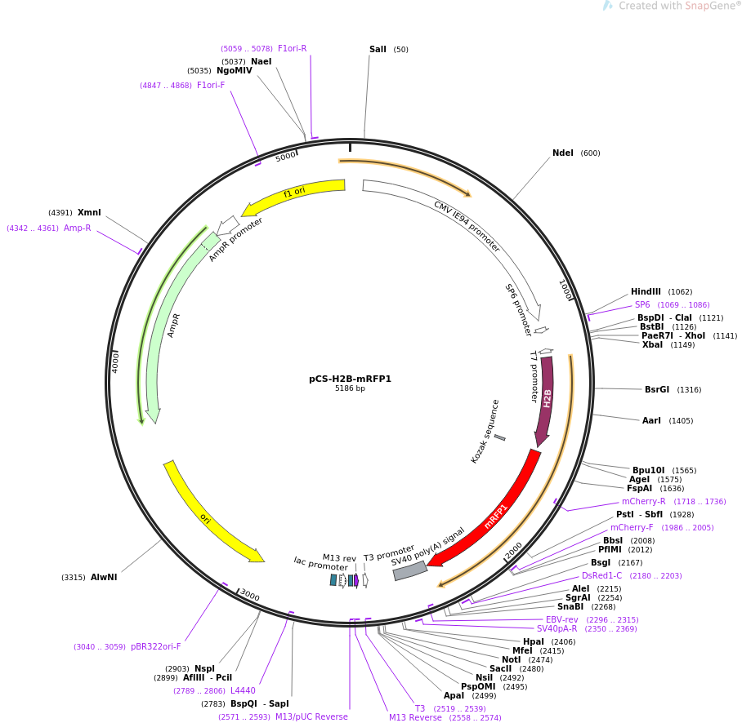
Plasmid Purification
pCS-H2B-mRFP
MCS- multiple cloning site
H2B- Histone 2B
RFP- Red Fluorescent Protein
OriV
AmpR- Ampicillin Resistance

Slide 9
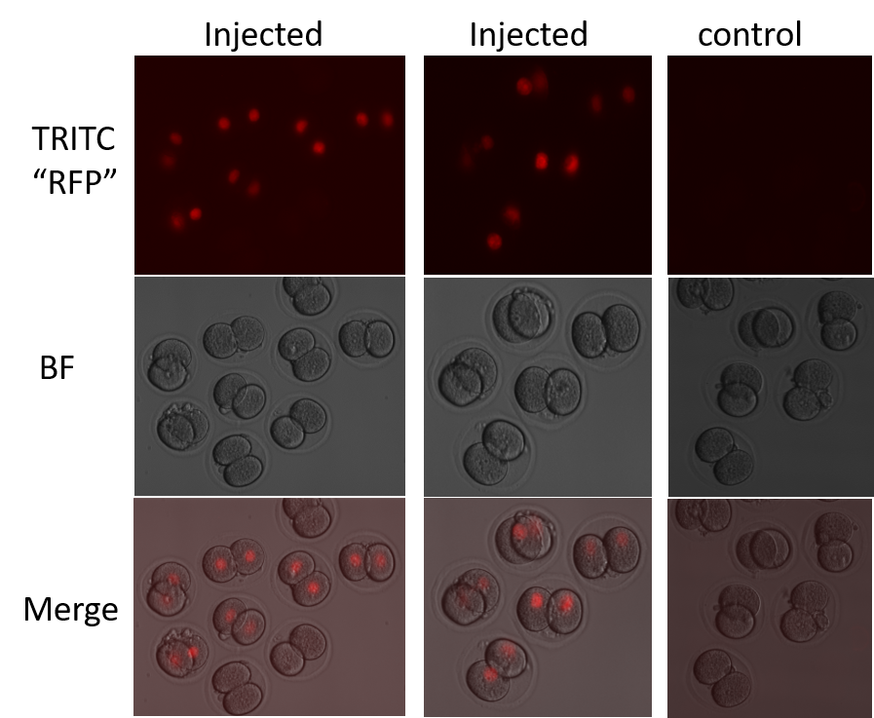
Immunocytochemistry

Slide 10
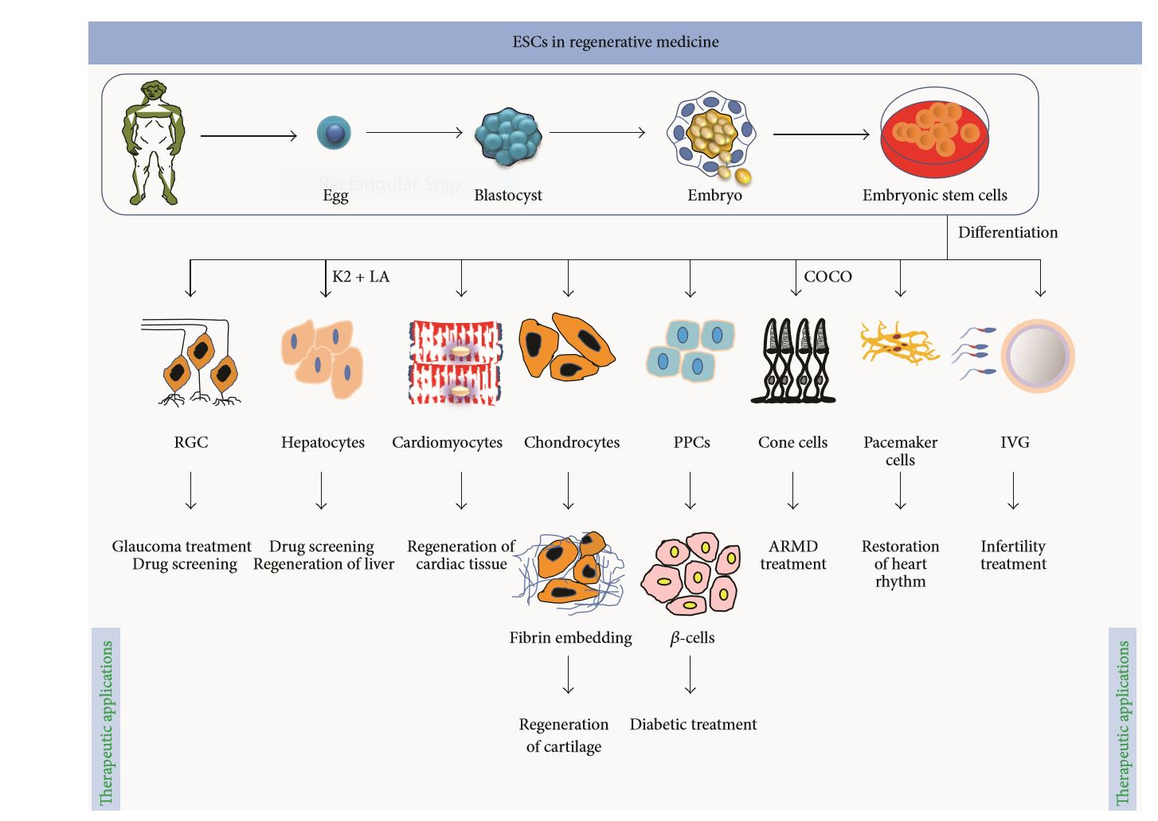
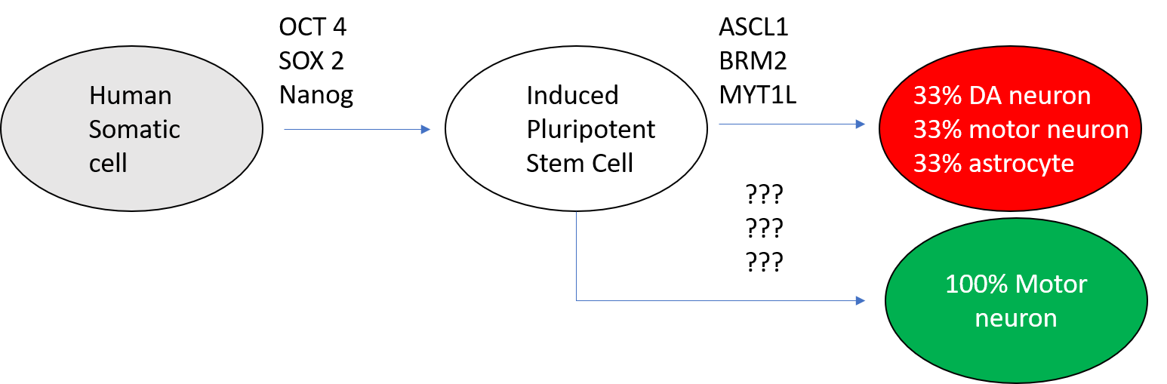
Future Research (Neuro-regenerative Stem Cells)
New insight into stem cells
Cardiac Stem cells
Neural Stem Cells
Mechanism of Cellular differentiation

Slide 11
References

